Slide 1
Final Project Proposal
Object Detection
Group 16 :
Eric Liu
Atik Garg
Siméon Gaumart

Slide 2
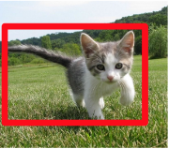

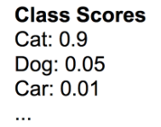
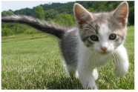
Background
Original Image
Localization
Segmentation
Classification

Slide 3
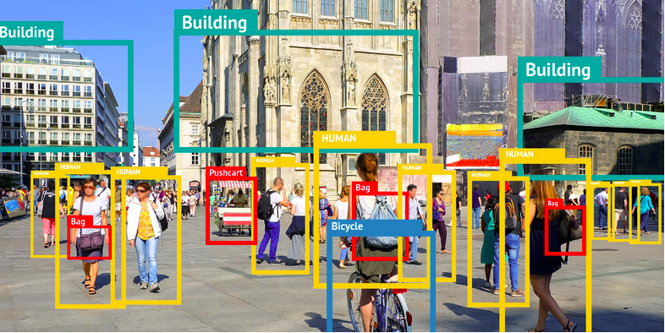
Object Detection

Slide 4
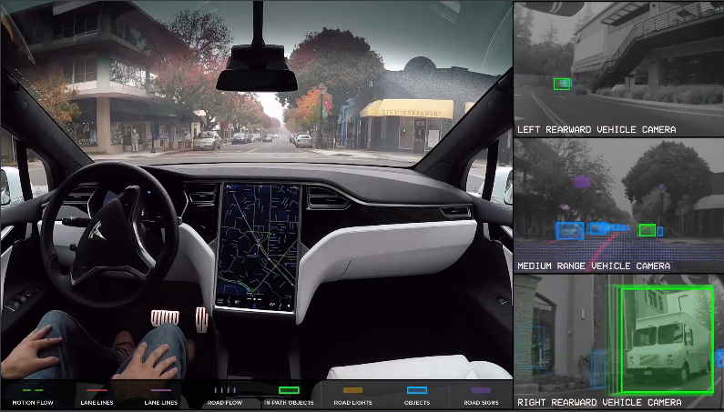
Example
Advanced Driver Assistance Systems / Self Driving
Ex : Tesla autopilot
Detect :
other cars
driving lanes
signs
pedestrians
...
https://player.vimeo.com/video/192179726

Slide 5
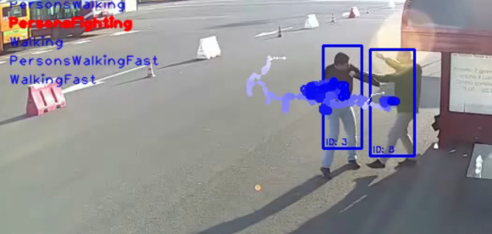
Example
Video Surveillance
Ex : Viulib - Vicomtech
Real-time event detection
https://www.youtube.com/watch?v=QcCjmWwEUgg

Slide 6
YOLOv3

Slide 7
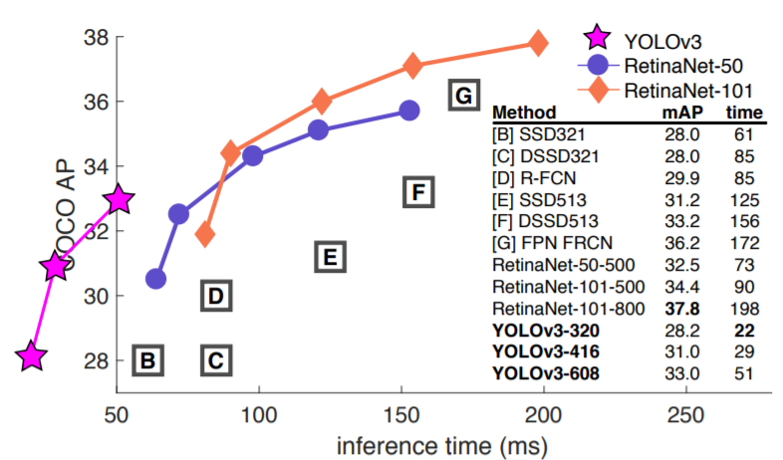
Aims
Although available object detection are very good, but we find out the some method maybe useful to improve the accuracy.
Data Augmentation
Improvements in Darknet-53

Slide 8
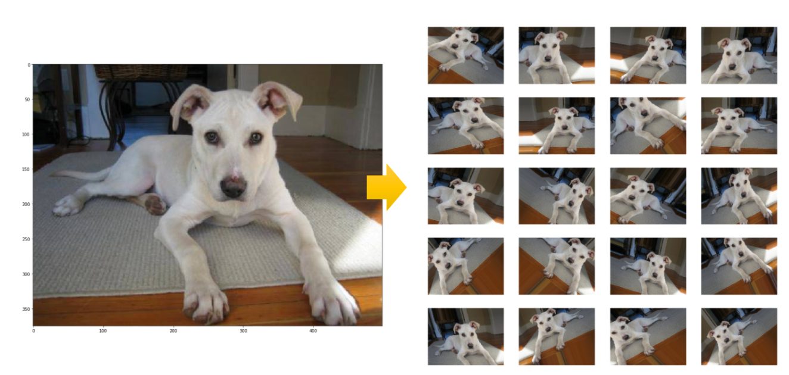
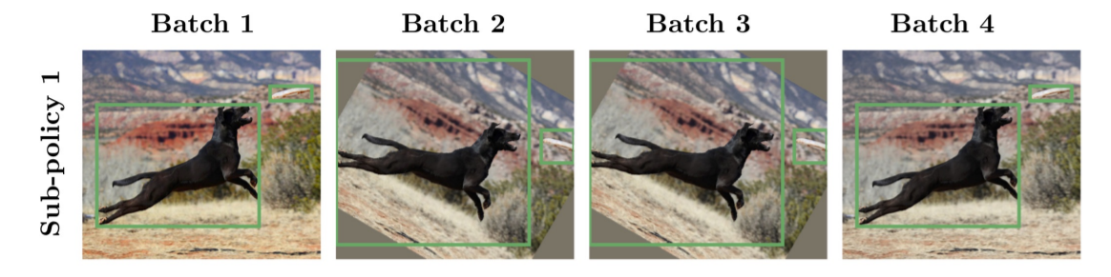
Aims
1. Data Augmentation
https://arxiv.org/pdf/1906.11172.pdf

Slide 9
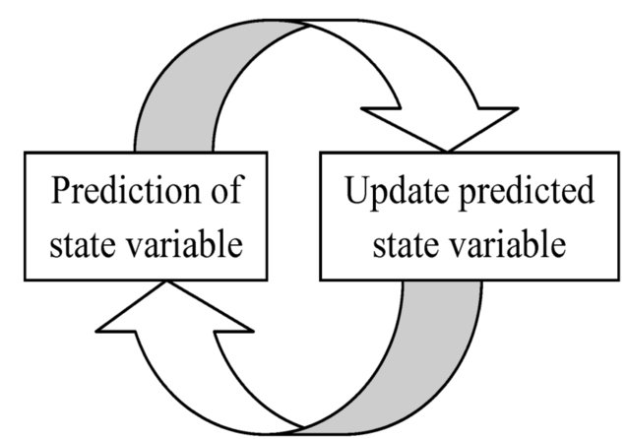
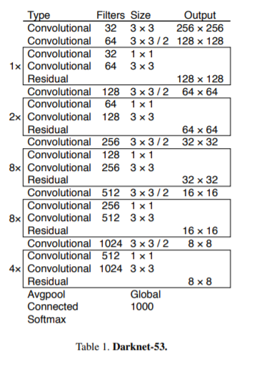
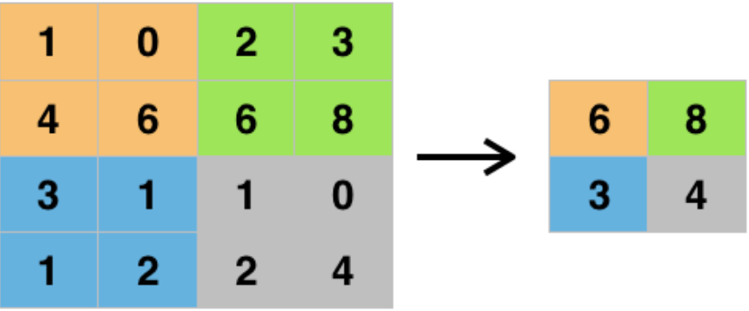
Aims
Improvement in YOLOv3(Darknet-53)
Max pooling
https://deepai.org/machine-learning-glossary-and-terms/max-pooling
Notes:
here are very few implementations of the YOLO algorithm that exists on the web. The Darknet is one such open-source neural network framework written in C and CUDA and serves as the basis of YOLO. It is fast, easy to install, and supports CPU and GPU computation. Darknet is used as the framework for training YOLO, meaning it sets the architecture of the network. The first author of Darknet is the author of YOLO itself(J Redmon).

Slide 10

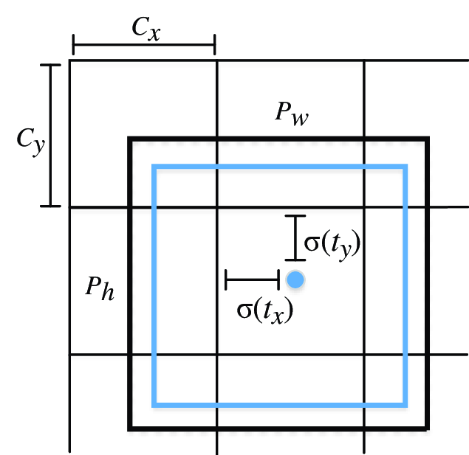
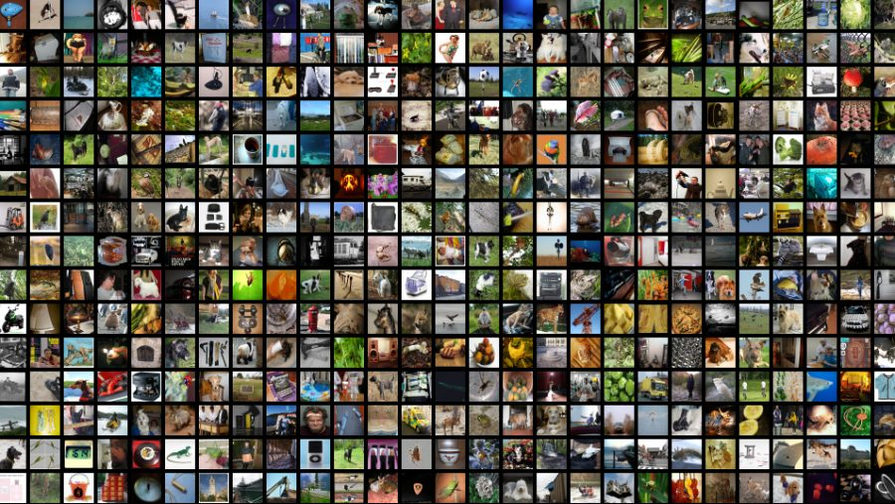
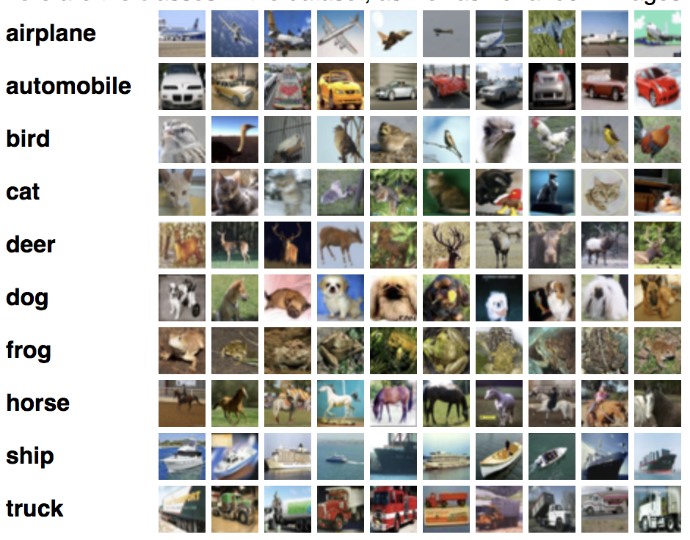

Flow Chart
Bounding
Box
Prediction
Input Dataset
Data
Preprocessing
Classification
Analysis

Slide 11
Data preparation

Slide 12
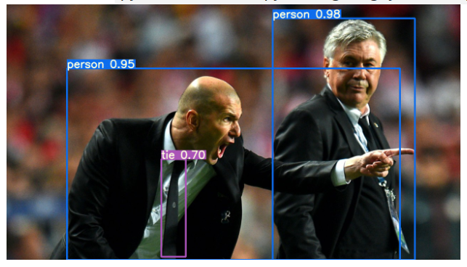
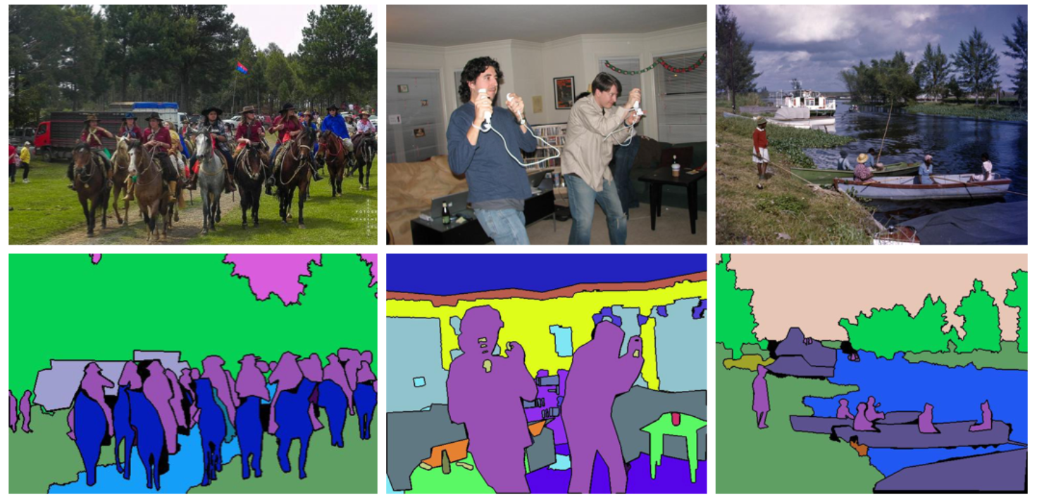
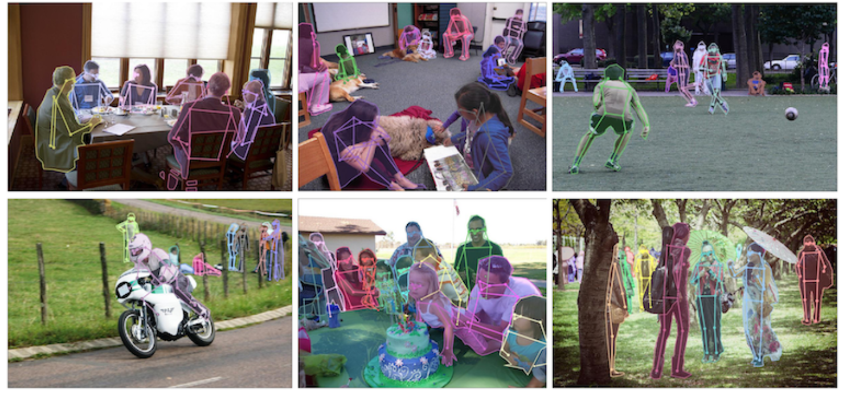
What is COCO ( Comment Object detection)
COCO is a popular dataset in computer vision.
COCO contains object detection, segmentation, and captioning dataset, and corresponding label form, so it can be used in many computer vision task, examples are as follows:
Object detection
Panoptic segmentation
Pose estimation
http://cocodataset.org/

Slide 13
Why use COCO?
1. COCO have 80 object categories.
2. Contains 82,783 training images, 40,504 verification images and 40,775 test images, 270k segmented people and 886k segmented objects.
3. Provide accurate label to the second decimal place.
4. It is a standard database, we can compare the result easily.

Slide 14
Reference
https://www.youtube.com/watch?v=QcCjmWwEUgg
https://player.vimeo.com/video/192179726
http://cocodataset.org/
http://cocodataset.org/#panoptic-2019
http://cocodataset.org/#keypoints-2019
https://arxiv.org/pdf/1405.0312.pdf
https://arxiv.org/pdf/1804.02767.pdf
https://arxiv.org/pdf/1906.11172.pdf
https://deepai.org/machine-learning-glossary-and-terms/max-pooling

Slide 15
Thanks for your Attention

